Slide 1
MagSail - Preliminary Calculations and Corrections to Phase I proposal
Athul P. Girija, Sep 01

Slide 2
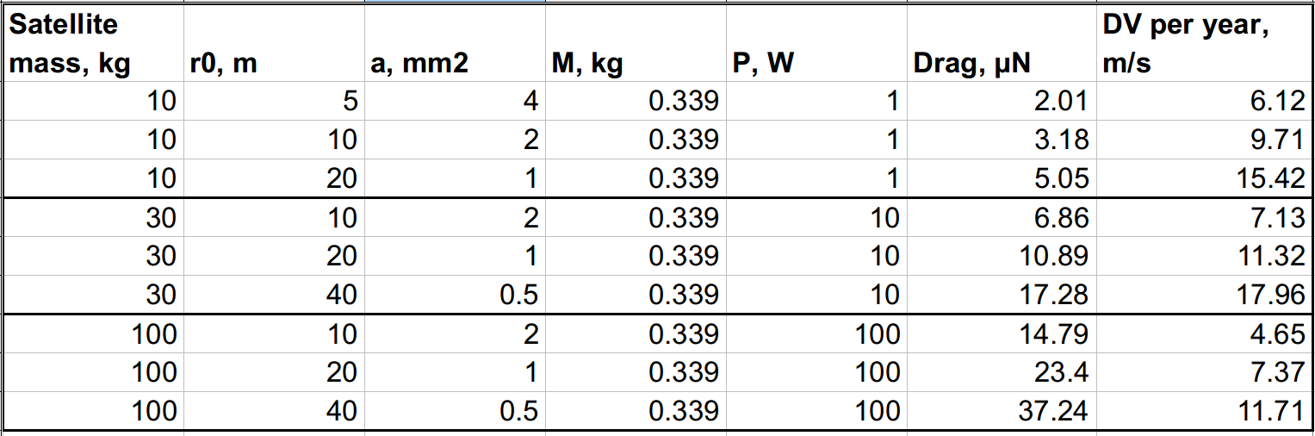
Corrected numbers for Table 1 in the proposal

Slide 3
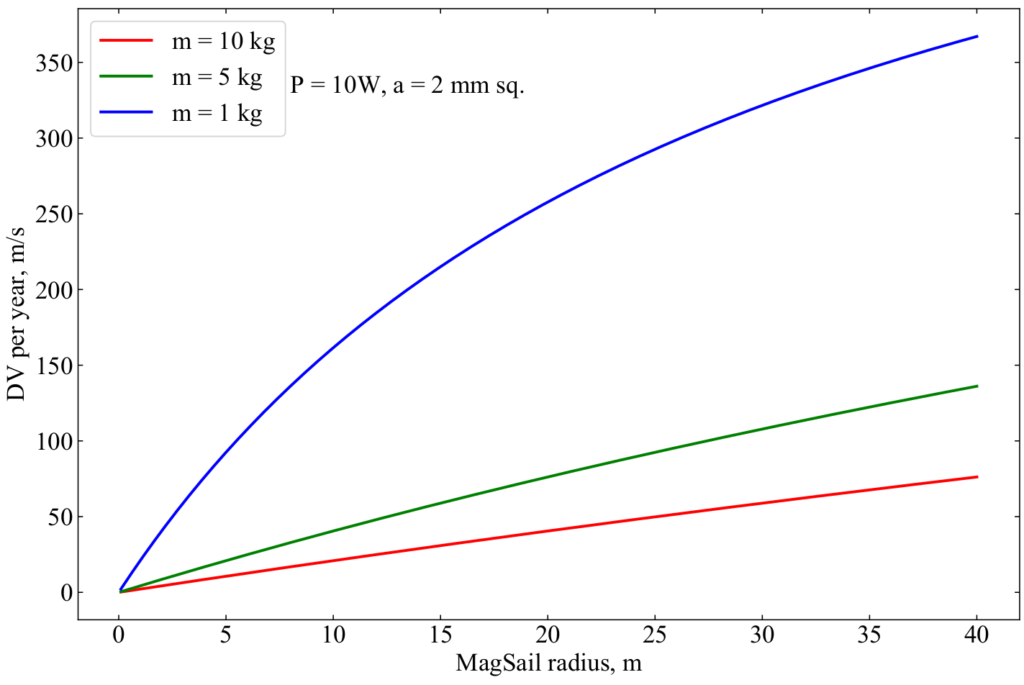
DV capability trade study 1

Slide 4
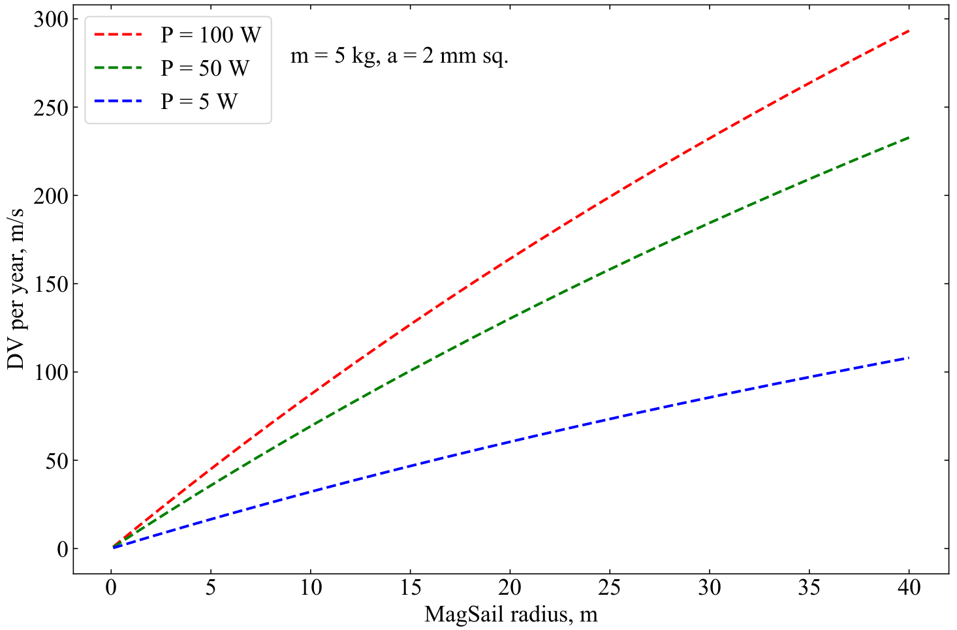
DV capability trade study 2

Slide 5
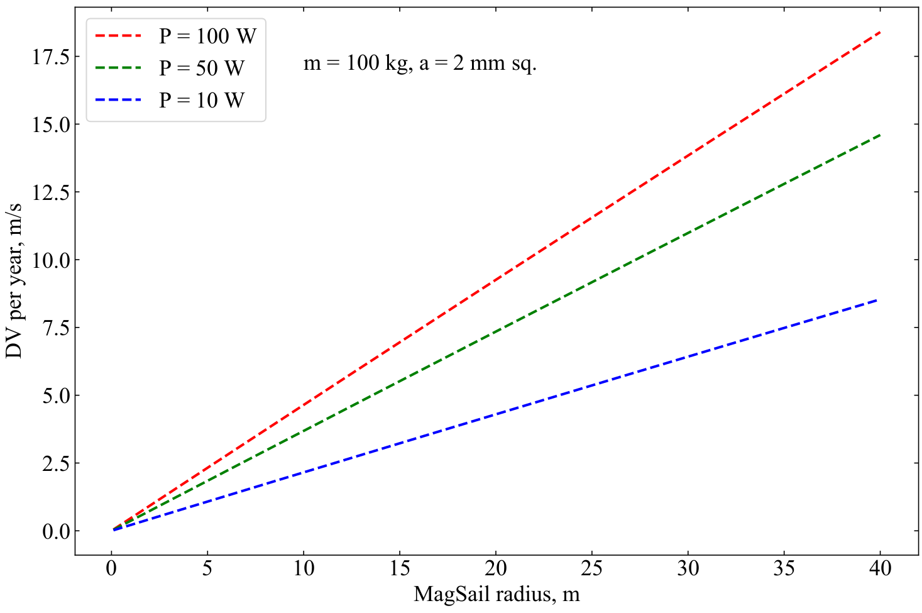
DV capability trade study 3

Slide 6
Summary
Corrected delta V per year numbers from proposal document
Code to do trade studies among magsail radius, power, wire radius, etc. done.
Sample trade studies performed, once we have a better estimate of the baseline concept more studies can be done.

